Slide 1
Voltage and Current mode control
By Stig Munk-Nielsen

Slide 2
Agenda
Voltage mode
Small signal model
Transfer functions
Block diagram
Current mode
Current programmed control
Small signal model
Block diagram
Summary behavior of V and I control
Stability of current mode for D>.5
Exercise

Slide 3
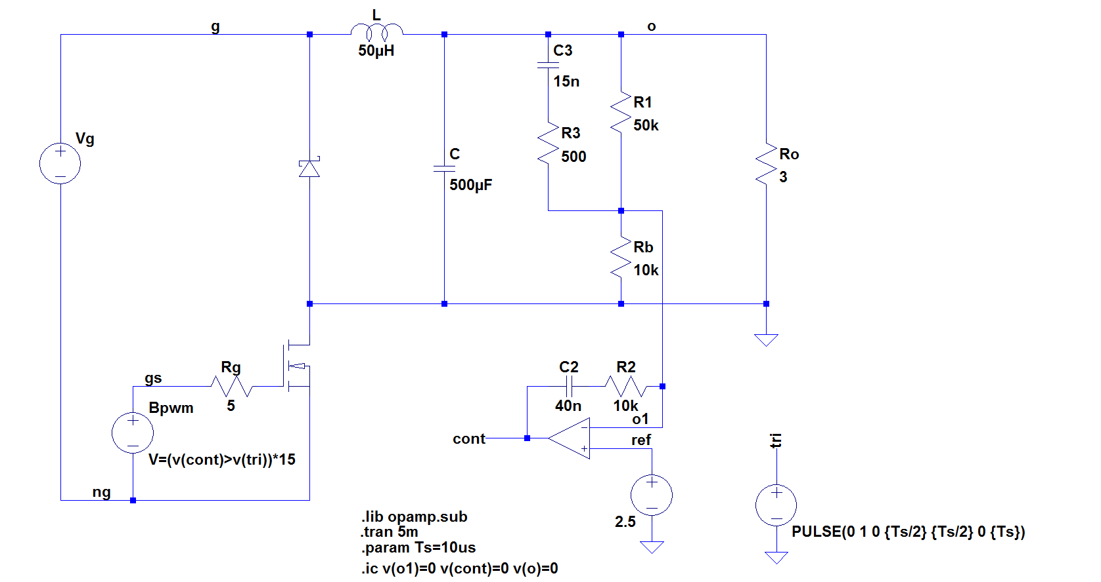
Voltage mode control : Buck type

Slide 4
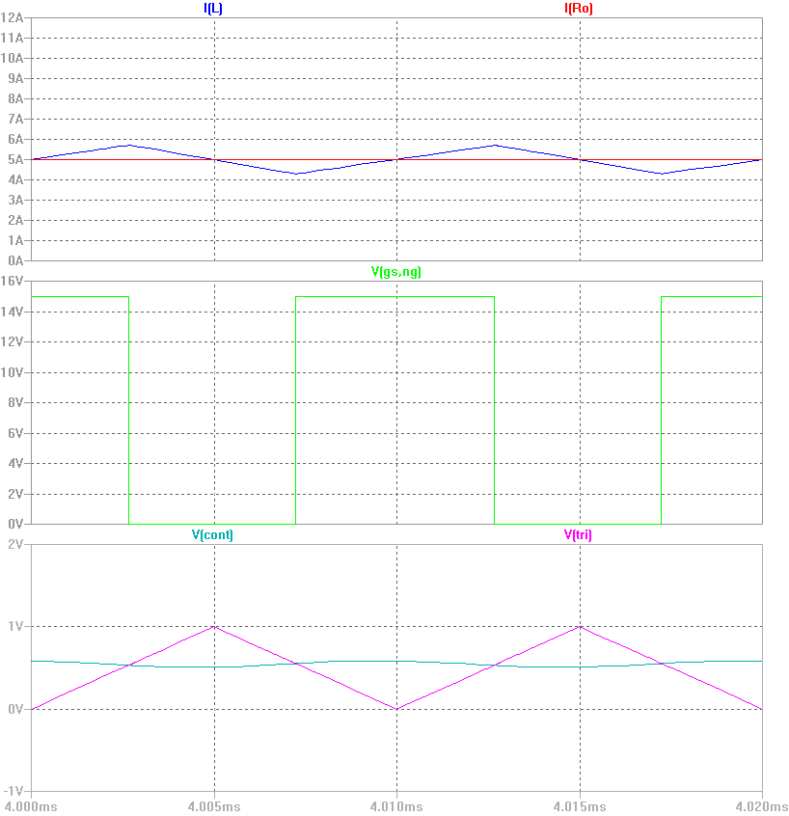
Buck converter switching waveforms

Slide 5


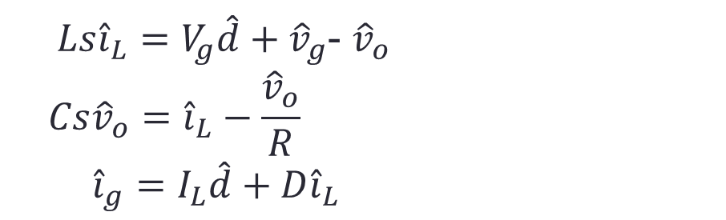



Voltage mode control
Buck converter
Small signal model
$Ls{\hat{i}}_{L}=V_{g}\hat{d}+{\hat{v}}_{g}$- ${\hat{v}}_{o}$
$$Cs{\hat{v}}_{o}={\hat{i}}_{L}−\frac{{\hat{v}}_{o}}{R}$$
${\hat{i}}_{g}=I_{L}\hat{d}+{D\hat{i}}_{L}$
$$\hat{d}$$
$${\hat{v}}_{o}$$
$${\hat{i}}_{L}$$
$${\hat{i}}_{g}$$
$${\hat{v}}_{g}$$

Slide 6

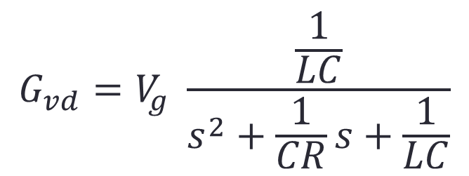

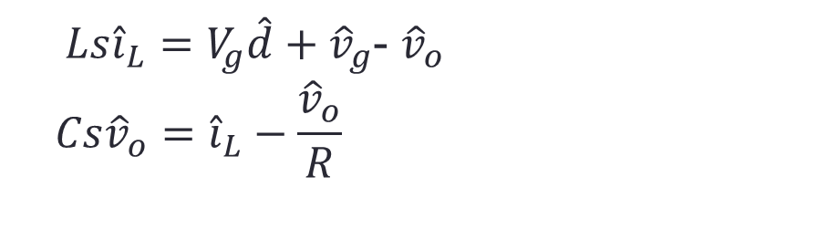
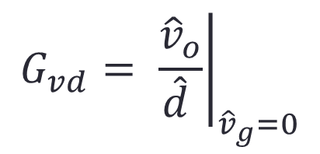

Control-to-Output function
$$\hat{d}$$
$${\hat{v}}_{o}$$
$Ls{\hat{i}}_{L}=V_{g}\hat{d}+{\hat{v}}_{g}$- ${\hat{v}}_{o}$
$$Cs{\hat{v}}_{o}={\hat{i}}_{L}−\frac{{\hat{v}}_{o}}{R}$$
$$G_{vd}$$
$$G_{vd}=V_{g} \frac{\frac{1}{LC}}{s^{2}+\frac{1}{CR}s+\frac{1}{LC}}$$
$$G_{vd}= {\left.\frac{{\hat{v}}_{o}}{\hat{d} }\right|}_{{\hat{v}}_{g}=0}$$

Slide 7
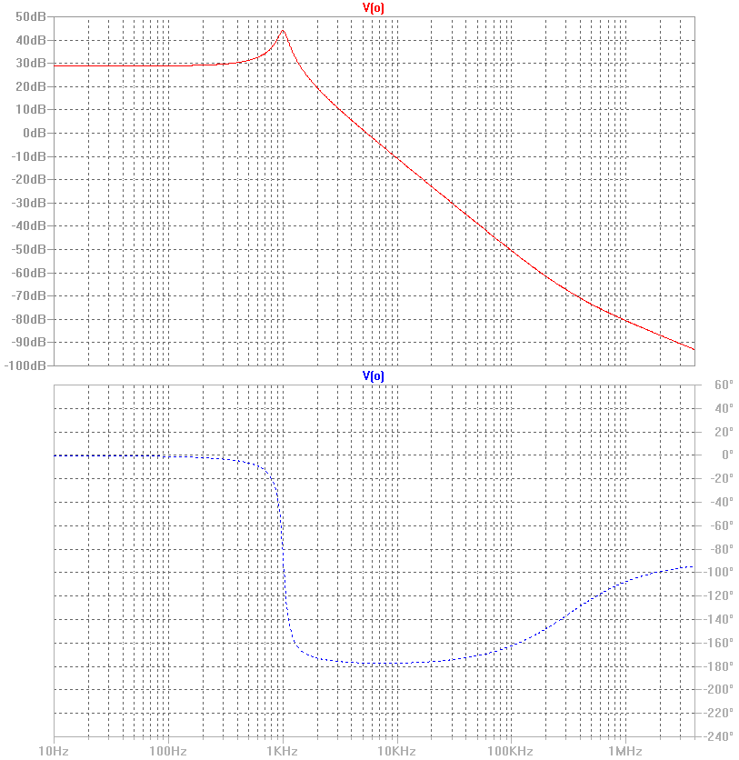
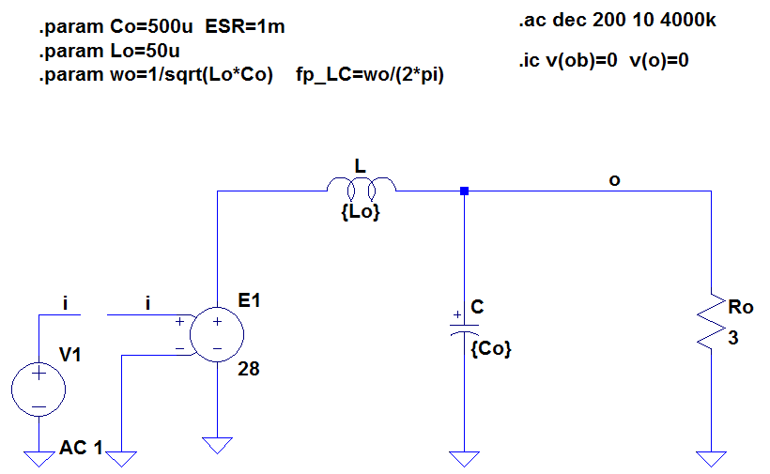
Bode plot of control-to-output function

Slide 8
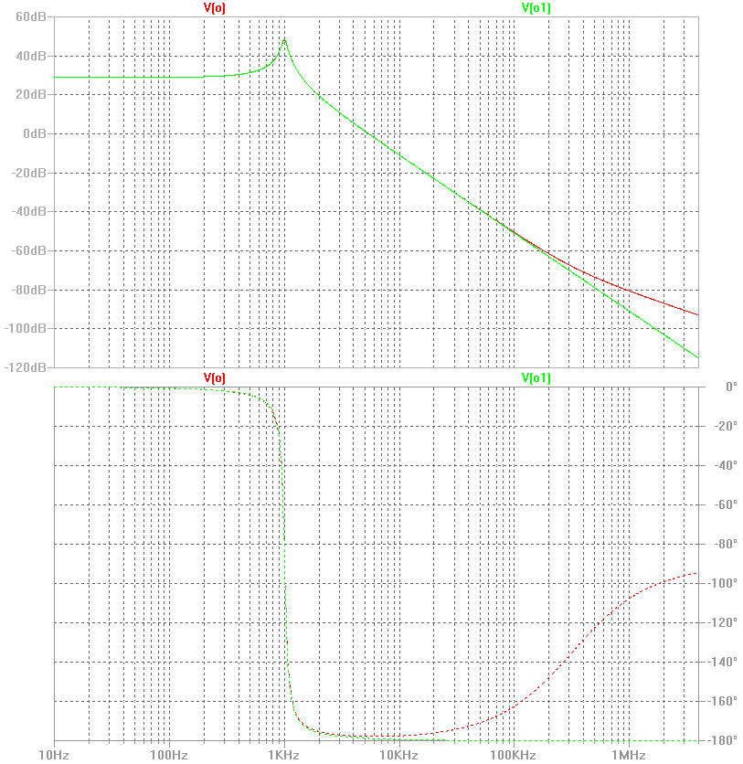
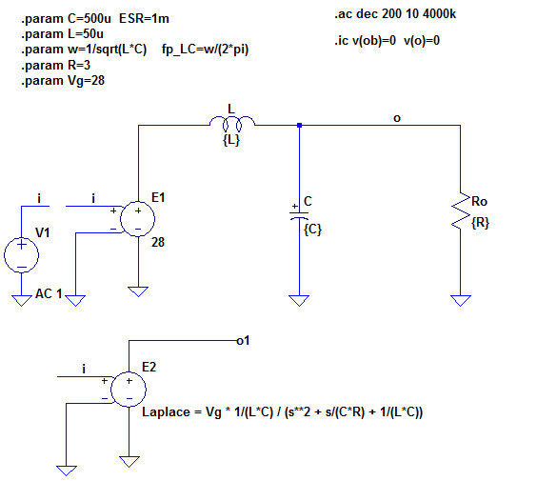
Bode plot of control-to-output function

Slide 9
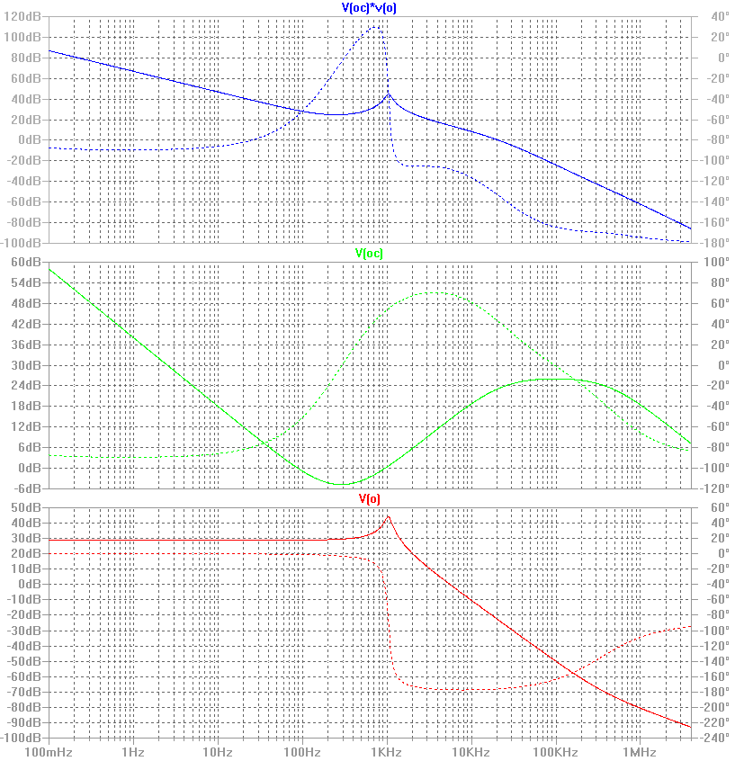
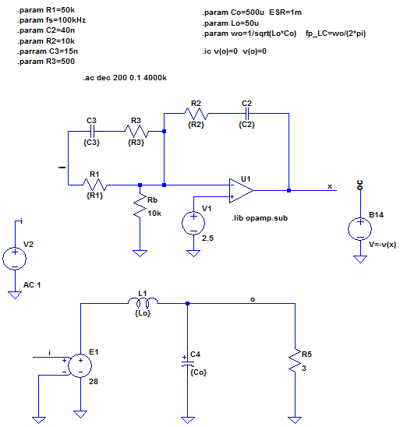




Output-to-control: ‘two – pole – two – zero’’ compensation
$$wp1$$
$$wp2$$
$$wz1$$
$$wz2$$

Slide 10
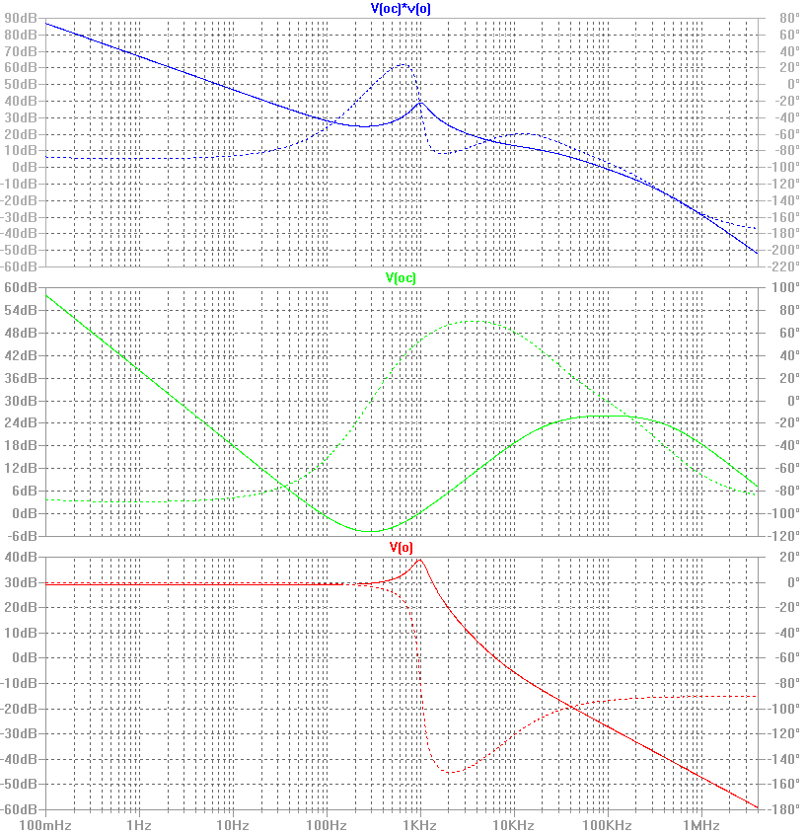

Output-to-control: Increase ESR !
ESR increase => Stability is lost: fc ~ fsw: not good fc < fsw/5

Slide 11
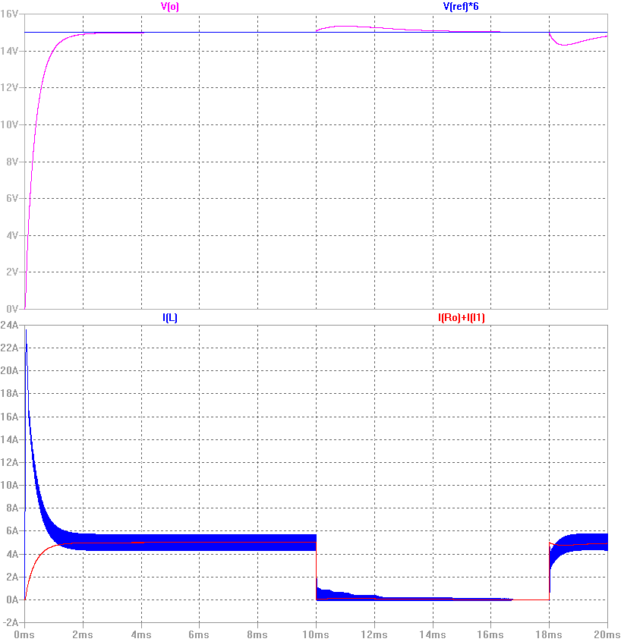
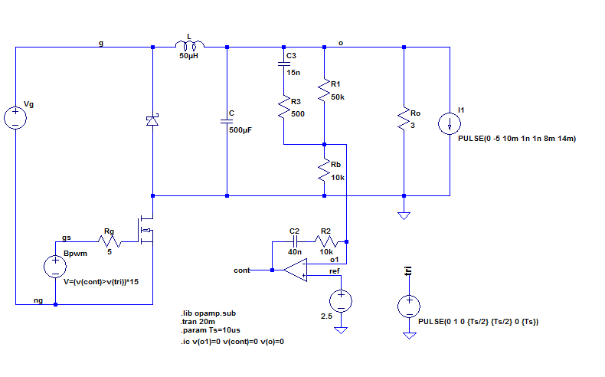
Voltage control: Simulation in time domain

Slide 12
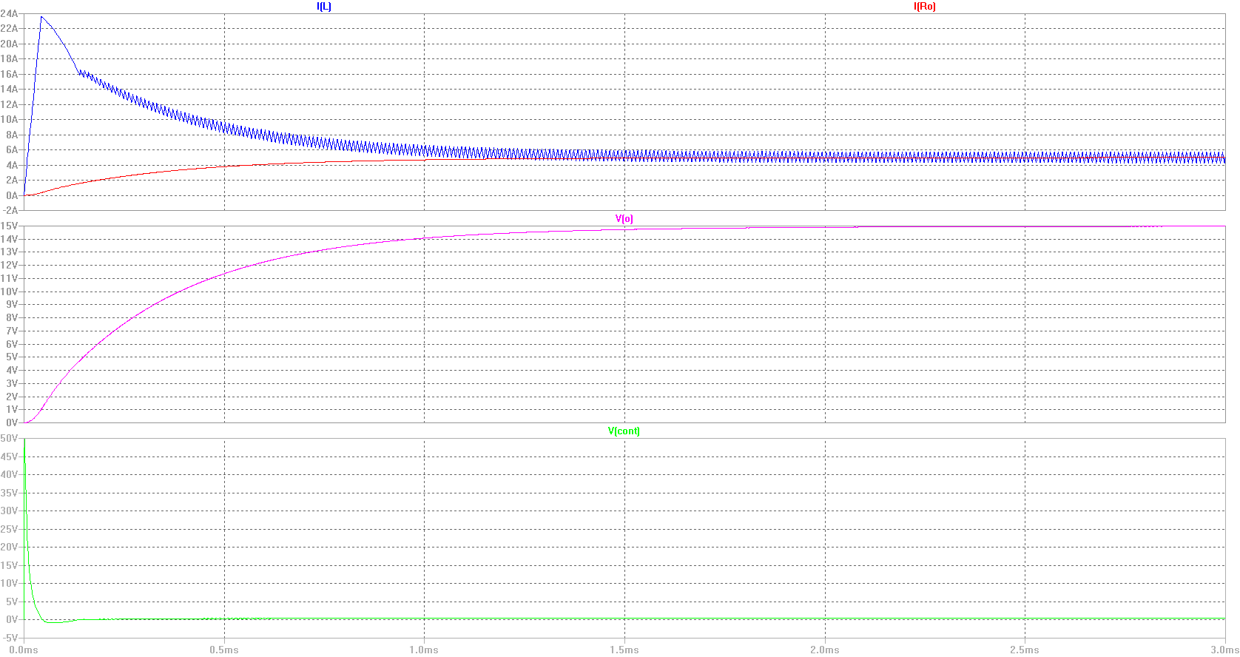
Initial step of V(o) from 0V to 15.0 V
At start control is lost – until V(o) increase to ~5V !! ~ 130 us

Slide 13
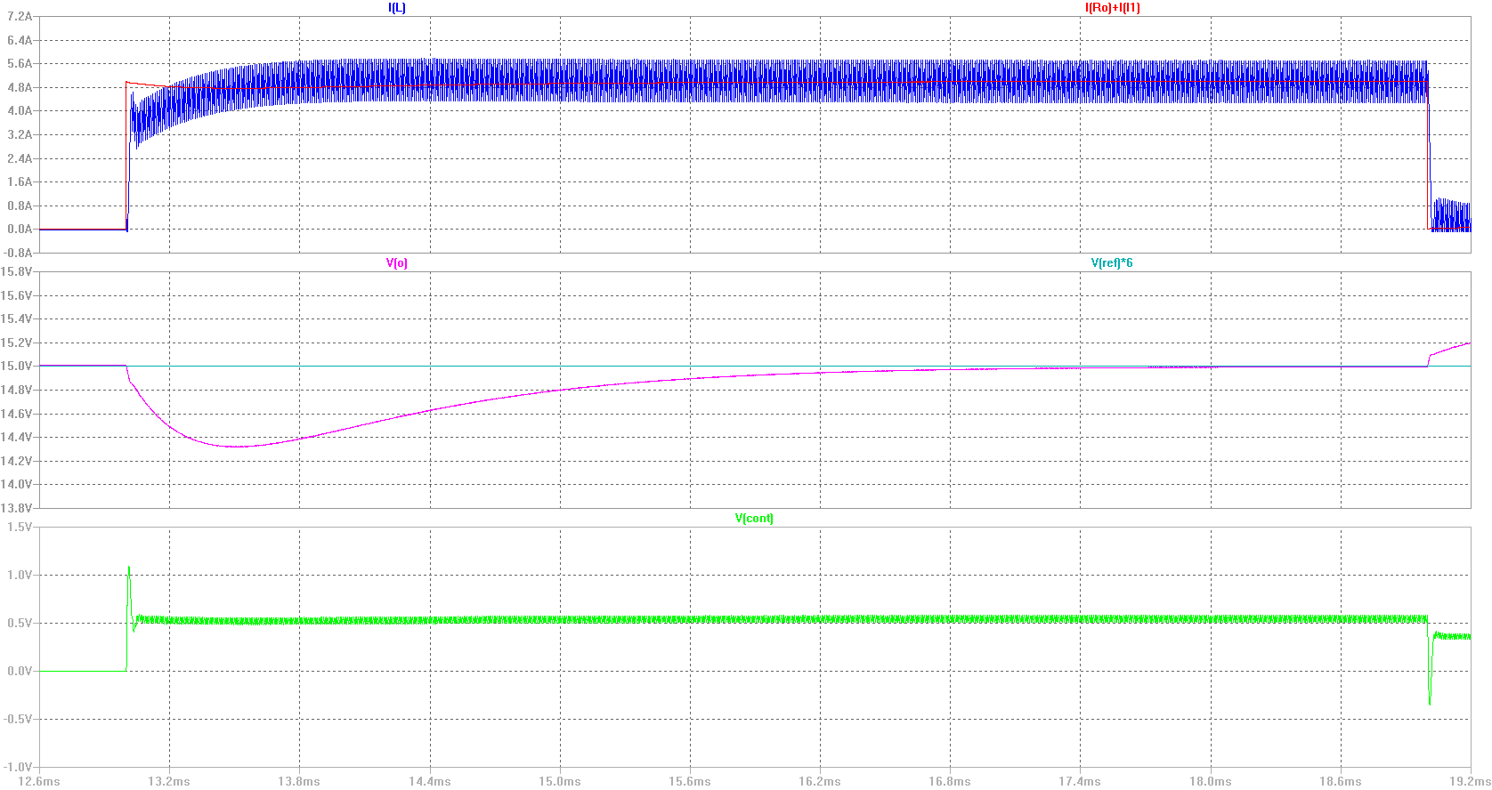
100 % load step – running converter
Swift control – control is only lost for a very short time now! ~ 10 us

Slide 14





Block diagram
$$G_{c}$$
$$G_{vd}$$
$$v_{ref}$$
$$\frac{K1\left(\frac{s}{wz1}+1\right)(\frac{s}{wz2}+1)}{(\frac{s}{wp1}+1)(\frac{s}{wp2}+1)}$$
$$V_{g} \frac{\frac{1}{LC}}{s^{2}+\frac{1}{CR}s+\frac{1}{LC}}$$

